Slide 1
Group 5 Image Watermarking
葉偉良 L091189
林奕君 309540009
彭思安 0616110
安本林 0616336

Slide 2
OUTLINE
Introduction
Life Cycles
Techniques
Conclusions
References

Slide 3
Introduction

Slide 4
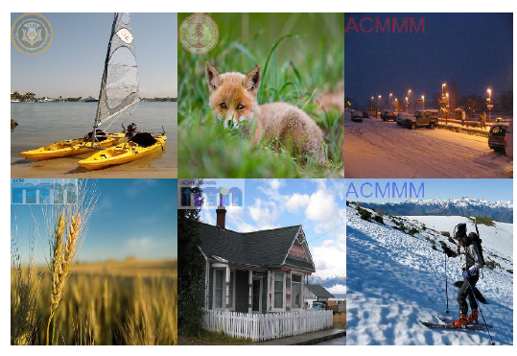
WATERMARKING
Credit to https://arxiv.org/pdf/2008.01919.pdf
A pattern of bits inserted into an, and cannot be manipulated.
Used to hide the information and provide copy right protection.

Slide 5
APPLICATIONS
Certification
eg. Identity Card, Passport
Authentication
To detect alterations and modifications in an image.
Copyright Protection
eg. Logo in screen when watching TV

Slide 6
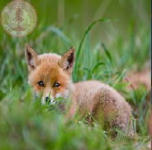
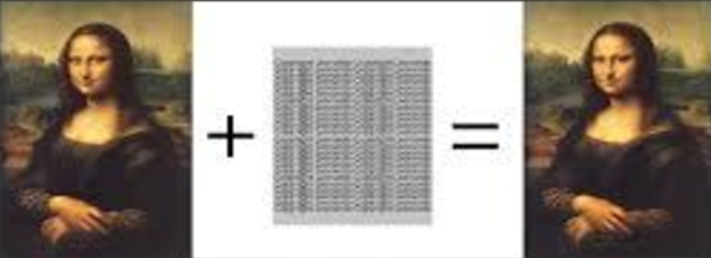
TYPES OF WATERMARK
Visible Watermark
Invisible Watermark
(p,q)
m
n

Slide 7
Life Cycles

Slide 8
LIFE CYCLES PHASES
Three phases of image watermark working:
Embedding Phase
Distortion Phase
Detection Phase
Watermarked Image
Watermarked Image with
Noise
Original Image
Watermark Embedding Algorithm
Attack/Noise
Watermark Detection Algorithm
Recovered Watermark
Watermark
Notes:
Embedding Phase: Embedding algorithm are used for embedding the watermark in original image
Distortion Phase: Some attacks are performed to modify or destroy the watermarked data.
Detection Phase: Detection algorithm are used to detect the watermark

Slide 9
Techniques

Slide 10
TECHNIQUES
Watermarking
Spatial Domain
Frequency Domain
LSB
SSM
DCT
DWT
DFT
Notes:
Notes:
The digital image watermarking falls in two main broad categories:
Spatial Domain Techniques: works on pixels and pixel value are modified for embedding the watermark
Frequency Domain Techniques: frequency domain coefficient are modified

Slide 11
SPATIAL DOMAIN
This technique presents the image in form of pixels.
Watermark is embedded in the cover image by changing values, intensity and the color of the selected pixels.
Benefits: simplicity, low computational complexity, consumes less time.

Slide 12
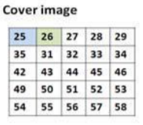
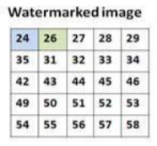
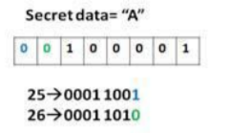
LEAST SIGNIFICANT BIT (LSB)
Each pixel of image is represented by an 8-bit stream.
the watermarks are added in the LSB of the selected pixels of the image.
Notes:
Remark:
Consider the first two pixels of the image are the selected pixels
And the first two bits of the secret data are going to added to those pixels.
Convert the selected pixel into bits, that is
25 -> 0001 1001, and 26 -> 0001 1010
Assign the bit of the secret data into least significant bit of pixels, that is
25 -> 0001 1001 -> 0001 1000 -> 24
And
26 -> 0001 1010 -> 0001 1010 -> 26

Slide 13
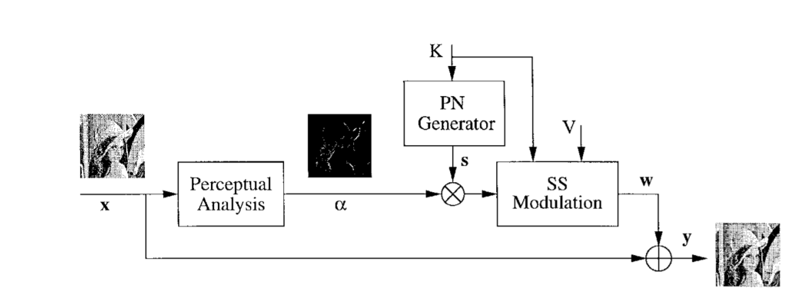
SPREAD SPECTRUM MODULATION (SSM)
linearly combining the host image with a small pseudo noise signal that is modulated by the embedded watermark.
Secret Key
Pseudorandom Sequence
Perceptual Mask
Message
https://ieeexplore-ieee-org.libezp2.utar.edu.my/stamp/stamp.jsp?tp=&arnumber=771069
Notes:
s - pseudorandom sequence generated using pseudo noise generator initialized to a state depending on value K
K - secret key only known to the copyright owner
α - perceptual mask obtained after analyzing original image using a psychovisual model (to guarantee invisibility)
V - a message taken from a finite discrete alphabet with M elements

Slide 14
FREQUENCY DOMAIN
In frequency domain techniques, the image is illustrated in the form of frequency.
Aims to embed the watermarks in the spectral coefficients of the image.
More successful, and more applied than spatial domain techniques.

Slide 15
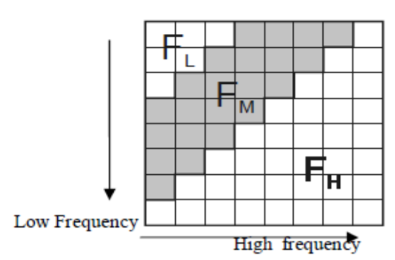
DISCRETE COSINE TRANSFORM (DCT)
Segment image to 8x8 blocks, divide the image into frequency band.
Apply forward DCT to each block
Apply block selection criteria
Apply coefficient selection criteria
Modify the selected coefficient. (watermarking)
Apply inverse DCT to each block
Credit to https://www.ijarcce.com/upload/2016/april-16/IJARCCE%20123.pdf
Notes:
Remark:
FL : lowest frequency component of the block,
FH : the higher frequency component
FM : the middle frequency component which is chosen as the embedding region.
It achieves good robustness against various signal processing attacks
because of the selection of perceptually significant frequency domain coefficients.

Slide 16
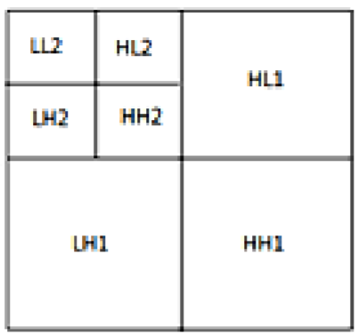
DISCRETE WAVELET TRANSFORM (DWT)
DWT of the image produces multi resolution representation of an image.
Horizontal details
Low frequency
High frequency
Vertical details
Credit to https://www.ijarcce.com/upload/2016/april-16/IJARCCE%20123.pdf
Notes:
It divides the image into high frequency quadrants and low frequency quadrants.
The low frequency quadrant is again split into two more parts of high and low frequency.
The process is repeated until the signal has been entirely decomposed.
Remark:
The low frequency coefficients are more robust to embed the watermark,
due to it contains more information of the image.
The reconstruct of the original image from the decomposed image is performed by IDWT

Slide 17
DISCRETE WAVELET TRANSFORM (DWT)
Host Image
Watermark Image
Apply N-level DWT of Host Image
Apply N-level DWT of Watermark Image
Embedding Function
Apply N-level inverse DWT
Watermarked Image
Notes:
It divides the image into high frequency quadrants and low frequency quadrants.
The low frequency quadrant is again split into two more parts of high and low frequency.
The process is repeated until the signal has been entirely decomposed.
Remark:
The low frequency coefficients are more robust to embed the watermark,
due to it contains more information of the image.
The reconstruct of the original image from the decomposed image is performed by IDWT

Slide 18
DISCRETE FOURIER TRANSFORM (DFT)
Decompose image in sine and cosine form.
Divided in two types:
1. Direct embedding:
The watermark is embedded by modifying DFT magnitude and phase coefficients.
2. Template based embedding:
The template is searched to resynchronize the image when undergoes transformation.
Notes:
Remark:
Template: a structure which is embedded in the DFT domain to estimate the transformation factor.

Slide 19
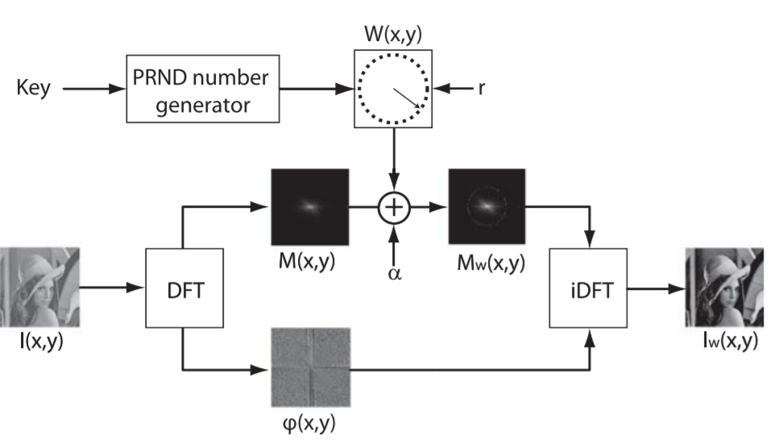
GENERATION OF DFT WATERMARK
Watermark
Radius
Magnitude of Image
Watermarked magnitude coeff.
Phase coeff.
https://www.spiedigitallibrary.org/journals/journal-of-electronic-imaging/volume-20/issue-03/033008/Discrete-Fourier-transform-based-watermarking-method-with-an-optimal-implementation/10.1117/1.3609010.full?SSO=1
Notes:
W(xi,yi) are elements of the watermark matrix
M(xi,yi) are the elements of the magnitude of the cover image
r is implementation radius, l denotes the length of the row-vector,
The watermark matrix is then embedded in the magnitude coefficient
The watermarked magnitude coefficients Mw(x,y) are combined with unaltered phase coefficients ϕ(x,y) and transformed back to the spatial domain

Slide 20
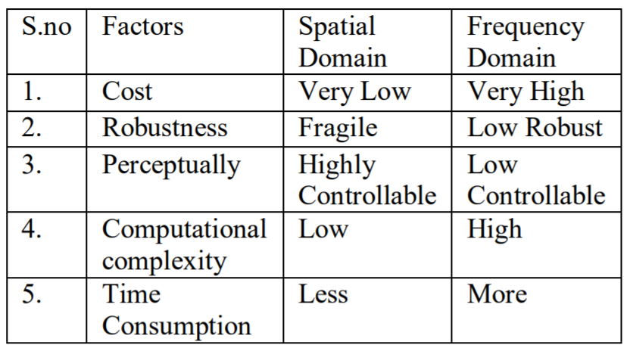
COMPARISON
Credit to https://www.ijarcce.com/upload/2016/april-16/IJARCCE%20123.pdf

Slide 21
COMPARISON
Methods | Pros | Cons
LSB | Simple Does not deteriorate the quality on images | Not robust against signal processing operations and attacks.
SSM | Resistance to natural interference and jamming prevent detection
DCT | Robust on low pass filtering, brightness, contrast adjustment, blurring Robust to different signal processing attacks. | Not robust against geometric attacks
DWT | Gives better visual image quality Allows better localization of watermarks More robust to wavelet transform based image compression | More complex High computation cost
DFT | Robust against geometric attacks | More complex High computation cost.

Slide 22
Experimental Result

Slide 23
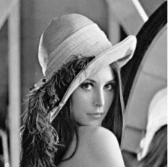

Peak signal-to-noise ratio (PSNR):
an image quality metrics.
Quantifies the quality of a reconstructed or corrupt image with reference to the ground-truth.
Higher value means quality better.
Host Image
Watermark
https://thesai.org/Downloads/Volume8No2/Paper_32-Comparison_of_Discrete_Cosine_Transforms.pdf

Slide 24
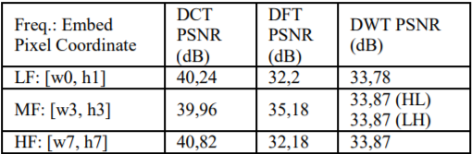
EXPERIMENTAL RESULT
PSNR of embedded image watermark in low frequency (LF), middle frequency (MF), and high frequency (HF) of image.
https://thesai.org/Downloads/Volume8No2/Paper_32-Comparison_of_Discrete_Cosine_Transforms.pdf
DCT embed on High Frequency is the best for image watermarking.

Slide 25
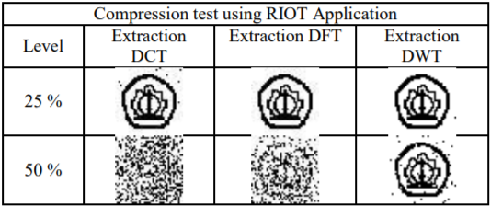
EXPERIMENTAL RESULT
PSNR of Compression Attack in Watermark DCT, DWT, DFT.
https://thesai.org/Downloads/Volume8No2/Paper_32-Comparison_of_Discrete_Cosine_Transforms.pdf
DWT Robust to Compression Attack

Slide 26
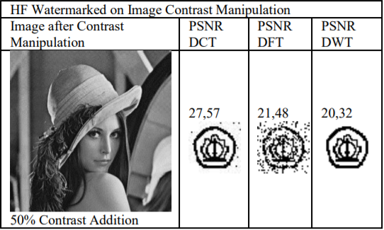
EXPERIMENTAL RESULT
PSNR of Contrast Manipulation in Watermark DCT, DWT, DFT.
https://thesai.org/Downloads/Volume8No2/Paper_32-Comparison_of_Discrete_Cosine_Transforms.pdf
DCT Robust to Contrast Manipulation

Slide 27
Conclusions

Slide 28
CONCLUSIONS
Frequency domain transformation methods are used widely in Digital Image Compression and Digital Image Watermarking.
It reduces the weakness of spatial domain transformation such as Least Significant Bit (LSB) methods which is more noise-tolerant.

Slide 29
References

Slide 30
REFERENCES
https://www.slideshare.net/nafees321/digital-watermarking-10187496
https://github.com/diptamath/DWT-DCT-Digital-Image-Watermarking/blob/master/paper.pdf
https://www.slideshare.net/qaisarayub/watermarking-inimageprocessing
https://www.slideshare.net/ankushkr007/digital-watermarking-15450208
https://medium.com/swlh/lsb-image-steganography-using-python-2bbbee2c69a2
https://www.pyimagesearch.com/2016/04/25/watermarking-images-with-opencv-and-python/
https://viblo.asia/p/opencv-watermarking-image-1VgZv4or5Aw
https://www.ijarcce.com/upload/2016/april-16/IJARCCE%20123.pdf
https://pdfs.semanticscholar.org/327e/4aee192e7a270d3876aa1b137ebc7711e1e8.pdf?_ga=2.64994219.587469682.1607119444-1030347285.1607119444
https://thesai.org/Downloads/Volume8No2/Paper_32-Comparison_of_Discrete_Cosine_Transforms.pdf

